Slide 1






X
GEEK VERSE
Smart Agri Rover (Krishi Saarthi)
Manchester City
RACHIT SANJEEV SONI
USAR GGSIPU EDC
IOT
page 01

Slide 2
Challenges in Efficient Crop Management Farmers struggle with inconsistent irrigation and crop management due to the lack of real time data . Uncertainty in soil conditions and weather leads to inefficient use of resources . Difficulty in predicting and preparing for unexpected environmental changes reduces productivity . Our project targets these challenges by integrating smart sensing and real-time forecasting .
GEEK VERSE
page 02

Slide 3
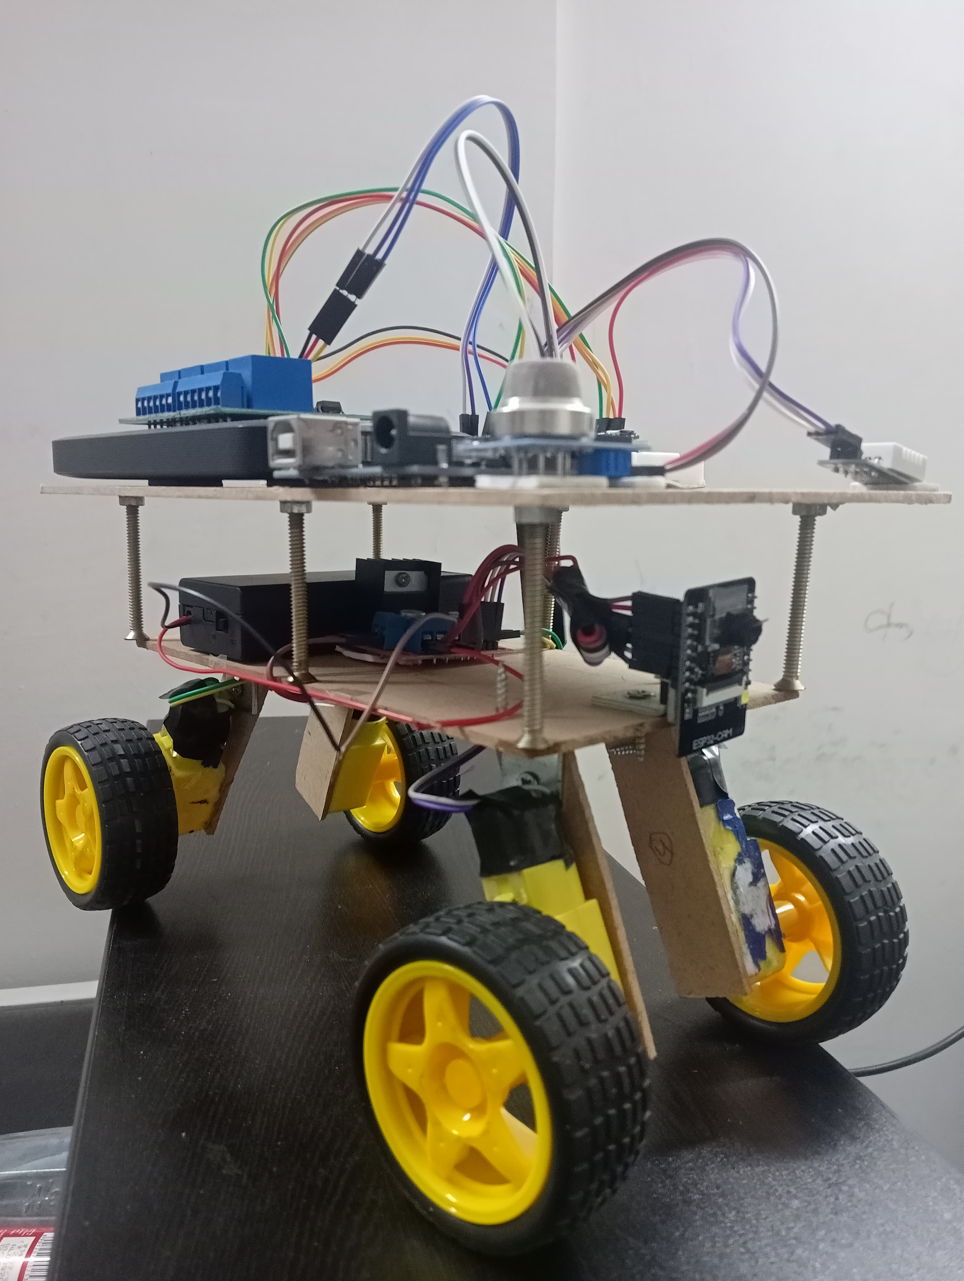

GEEK VERSE
An IoT enabled friend for precise and efficient agriculture
Our rover collects real time data using humidity , temperature, soil moisture, air quality sensors and visual inputs through precision camera .
The data is analysed to forecast environmental changes to support and execute irrigation decisions .
Farmers can monitor their fields and receive actionable insights via a mobile/web interface .
Unique because it has mobility, sensor fusion and smart farming analytics altogether in one compact system .
page 03

Slide 4


Tech
GEEK VERSE
Stack
SECTION 1
Hardware :
Arduino, ESP 8266 & ESP32 CAM
DHT 11/ DHT22 ( Temperature & humidity sensor )
Soil moisture Sensor
Air quality sensor ( MQ 135 )
Motor driver , Wheels, Chassis
page 04
SECTION 2
Software / Cloud :
C/C++ ( Embedded code )
Blynk IoT ( For cloud linking and consoling )
Firebase/AWS IoT/ Google Sheets for data logging

Slide 5
Economic Potential
GEEK VERSE
Feasibility
Low – Cost, Easily available components for production
Simple to integrate and easy analysis for different crops
Technically viable with existing hardware and cloud services
Viability
Scalable to large farms by deploying multiple rovers
Adaptable to different terrains and crop types
Smart algorithms to improve yield and reduce resource wastage
Can be monetized as a product for small scale farmers to aid and empower them
page 05

Slide 6
GEEK VERSE
Empowering Farmers with a Legion , they can trust
Smart Agri Rover revolutionizing farming with real- time, data driven decisions.
Increases efficiency, optimizes irrigation and aids in
environmental forecasting.
Helps bridge the gap between technology and agriculture.
Our journey so far involved research, prototyping
and successful initial field testing.
We thrive for finding practical problems and producing impactful practical solutions.
Team DetailsPARTH GUPTA
CHAITANYA SHARMA
ABHIJEET KUMAR
Rachit Sanjeev Soni
page 14

